Slide 1
PRTM Purchasing Procedure Updates
Building People and Communities

Slide 2
Changes and Benefits
Changes
All purchases must be pre-approved
Purchases will be handled by PRTM Main Office (Kayla Lee)
Updated forms in PDF format with digital approval
Benefits
User friendly fillable forms
Consistency within department and college
Streamlined process
Clear guidance
Audit Readiness

Slide 3
Updated Forms and Guides
Updated forms and guides are available on the PRTM website
Guides
Purchasing Guide
Reimbursement Guide
Forms
Purchase Request and Reimbursement Form (Non-Travel)
Travel Request Form- Domestic
Travel Request Form- International
In-State, Out-of-State, and International Travel Reimbursement Forms
Mileage Reimbursement Form

Slide 4
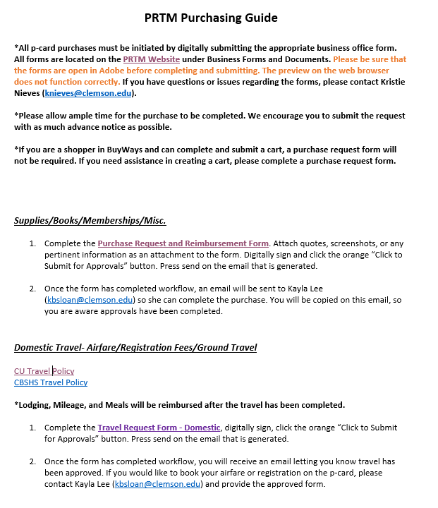
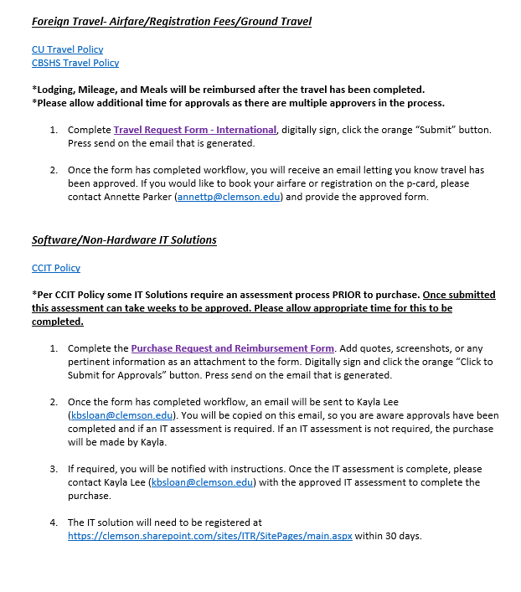
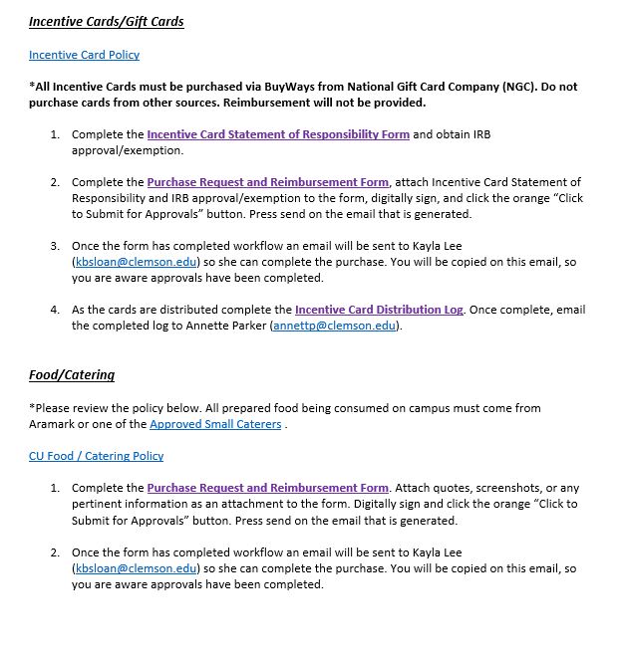
Purchasing Guide

Slide 5
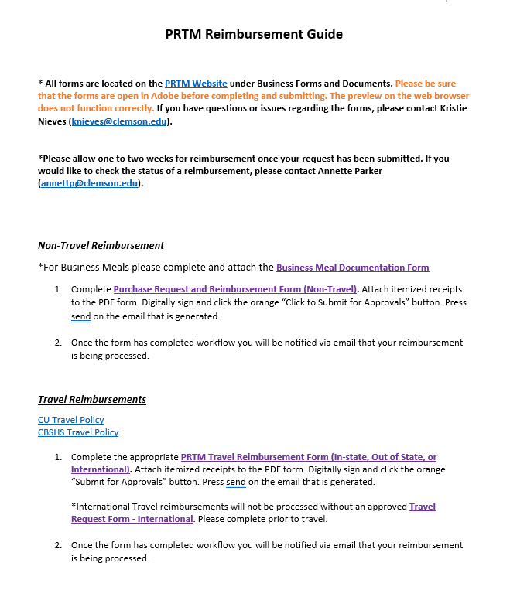
Reimbursement Guide

Slide 6
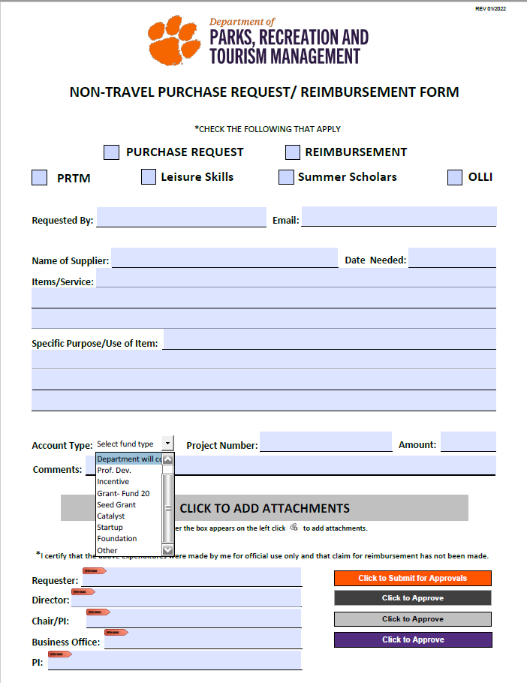
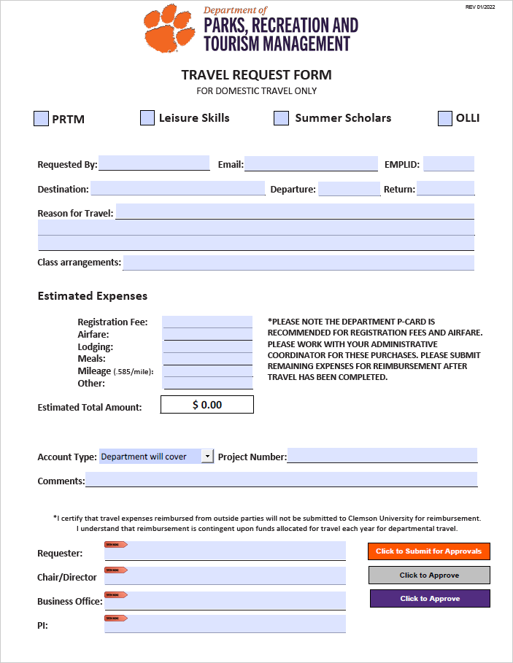
Updated Forms
Purchase Request Form Travel Request Form (Domestic)

Slide 7
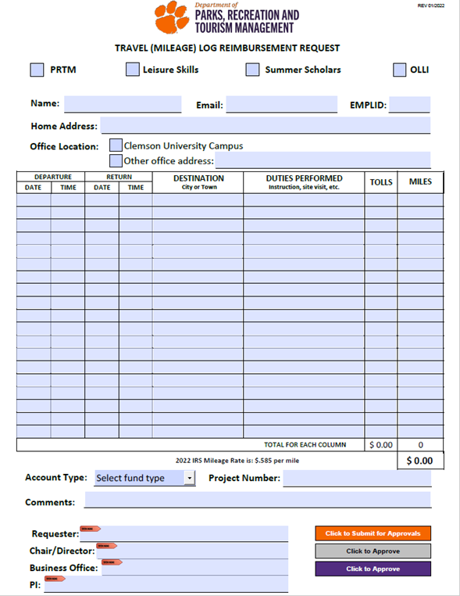
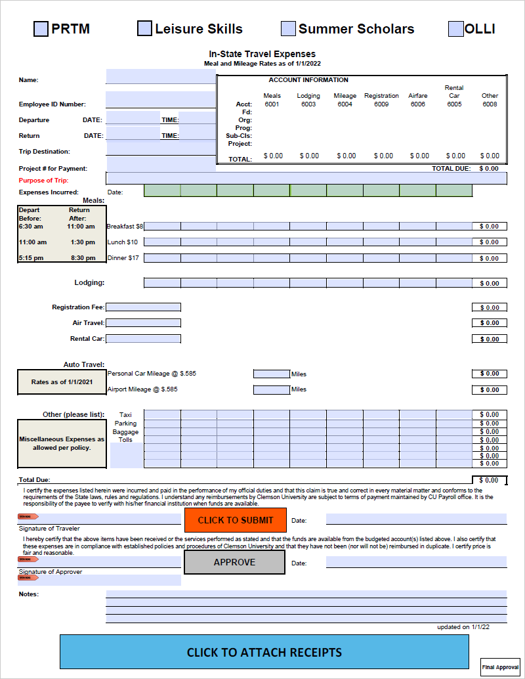
Updated Forms
Mileage Log Reimbursement Form Travel Reimbursement Forms

Slide 8
Purchase Request Example

Slide 9
Reimbursement Example

Slide 10
Limitations and Common Issues
Limitations
Unable for user to see workflow status
User must download form each time to ensure current version
Attachments must be attached to PDF form, not submission email
Attachments cannot be added to a form that has already been signed
Common Issues
Completing form in browser view and not in Adobe
Form signed before attachments are added
Appropriate boxes not selected at top of form

Slide 11
Optional Browser Settings
Chrome
>Settings
>Security and Privacy
>Site Settings
>Additional Content Settings
>PDF Documents
>Select Download PDFs

Slide 12
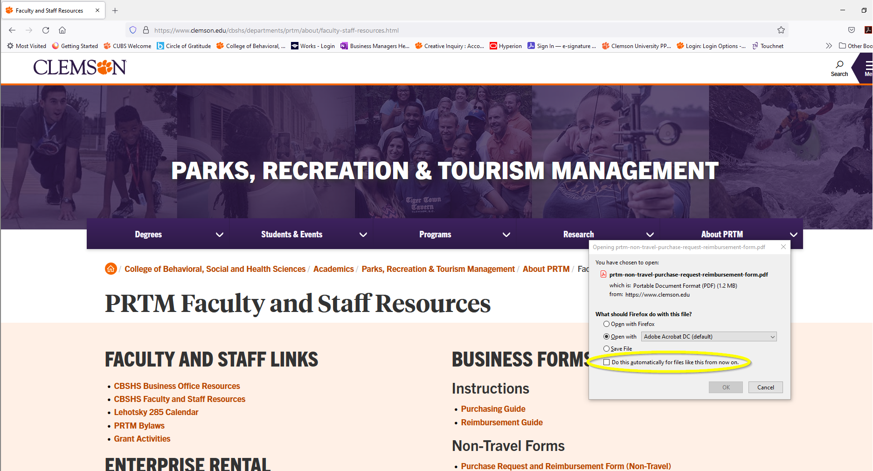
Optional Browser Settings
Firefox
Select “Do this automatically for files like this from now on.”

